Slide 1
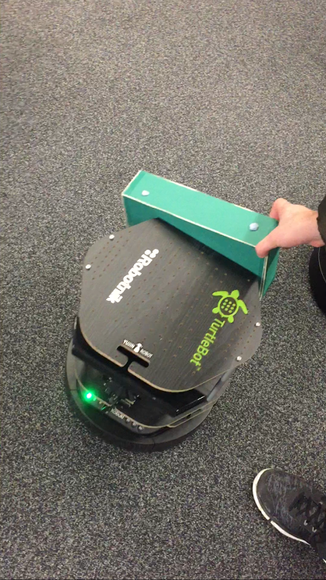
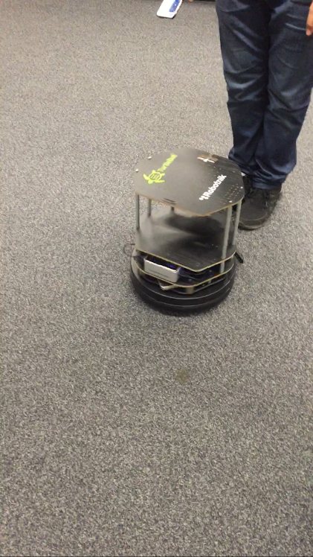
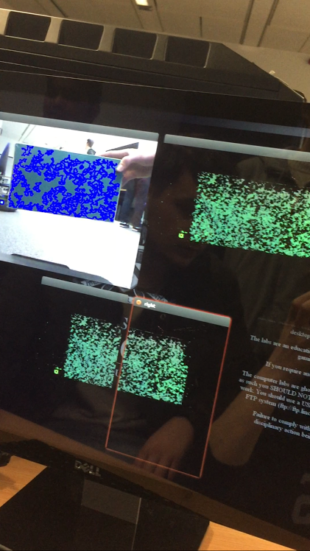
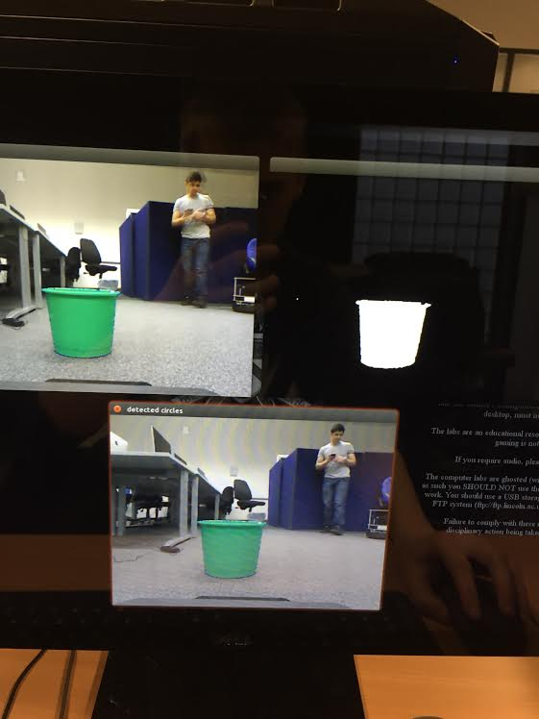


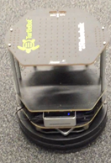

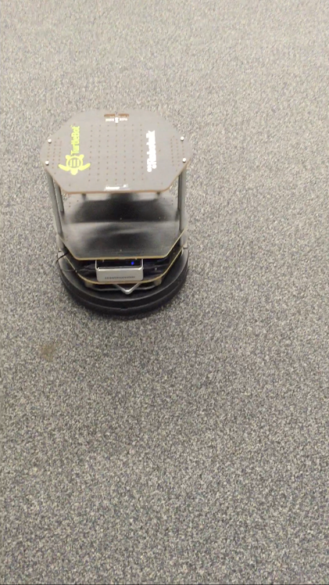
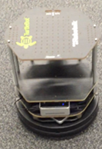
Noise Issue
Filter Implemented
BOOM!
Love Emotion
I use a laser scanner to measure distances for object avoidance
I use a Median filter to reduce the noise and find the colour Green
I Spin to avoid objects and search for the colour Green

Slide 2
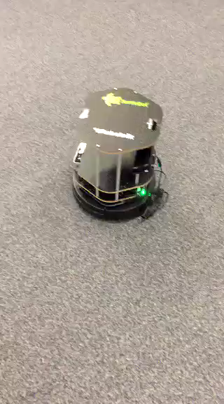
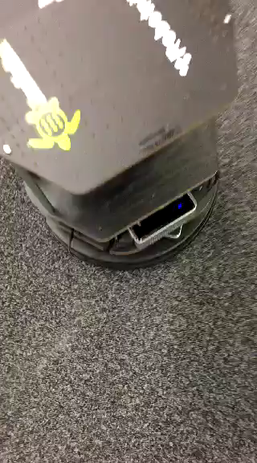
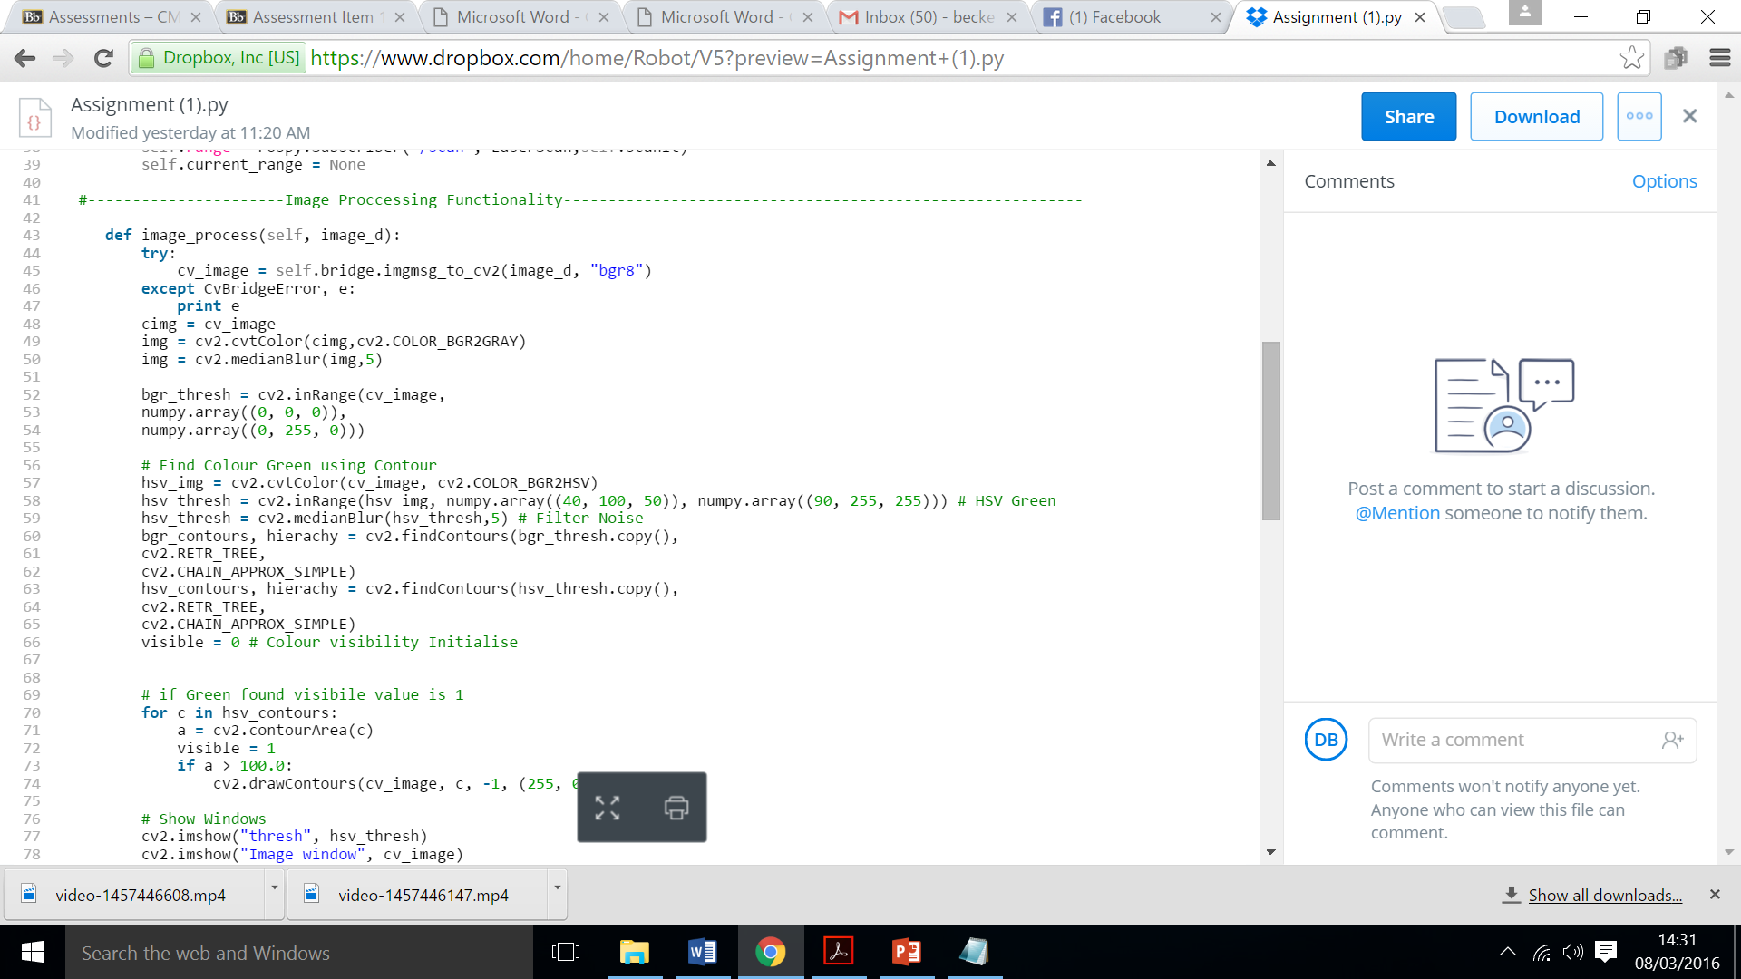
Design
Movement – Used a number of IF statements in relation to distance of objects and also whether the green object is visible “if self.current_range > 0.7 and visible == 0: “ then movement would occur.
Object Avoid – This feature also used IF statements “elif visible == 0 and self.current_range < 0.7:” If the statement is true then the robot will spin till no object is in its path “p.publish(spin_msg)”
Green Contour – This feature locates Green in the camera via HSV then adds a median filter to filter out any noise.
Performance
Movement – Simulation vs Reality
Movement of the robot was much more drastic, speeds had to be decreased due to the robots movement jolting about as evidenced in the video below.
Camera – sometimes the contour picked up more than one green object which confused the robot
Connection – many connection issues did occur throughout testing of the robot such as a loss of connection or the lagging of the camera feature
Love Emotion
END RESULT

